Slide 1

Traffic Light System For Car Crossroads
Components Required for Arduino Traffic Light Controller
Arduino UNO
Red LED’s (4 pieces)
Yellow LED’s (4 pieces)
Green LED’s (4 pieces)
220 ohm resistors (12 pieces)
Jumper cables
Breadboards

Slide 2
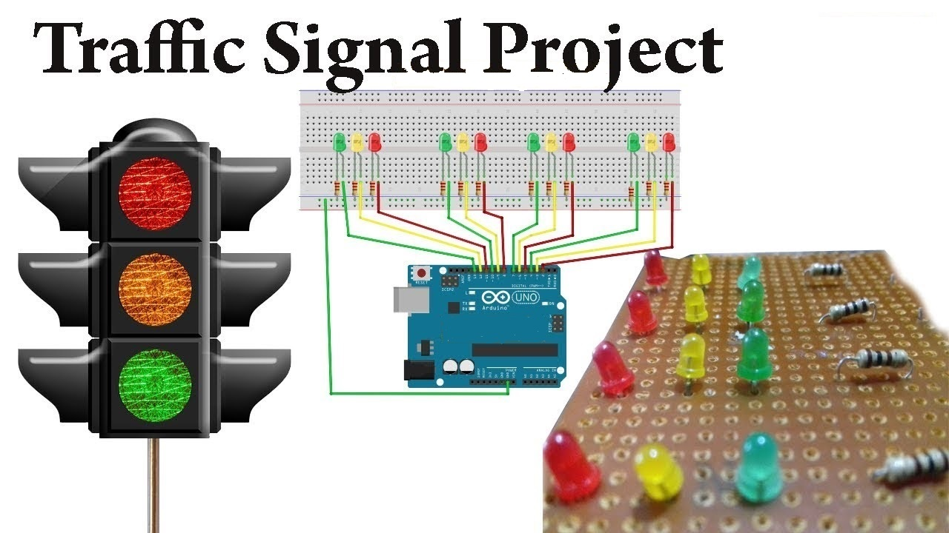
Traffic Light System For Car Crossroads
Circuit Diagram for Arduino Traffic Light Controller

Slide 3
Traffic Light System For Car Crossroads
Working Principle Of Arduino Traffic Light Controller
At the beginning , green light of signal 1 and red lights at other signals will light up , in order to give time to the vehicles at signal 1 to pass.
Next after 9 seconds, the yellow light at signal 1 will light up to give an indication that the red light at signal 1 is about to come up and also to give an indication to the vehicles at signal 2 that the green light is about to light up.
Then after 3 seconds, red light at signal 1 will come up and green light at signal 2 will come up meaning vehicles at signal 1 must stop and vehicles at signal 2 can pass .
In the same way the traffic light controller will work for the signal 3, signal 4 and the system will keep looping.

Slide 4
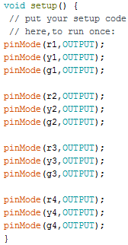

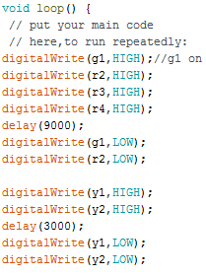
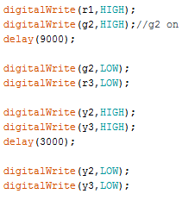
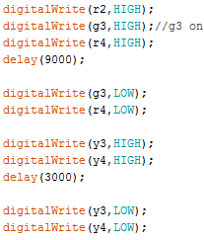
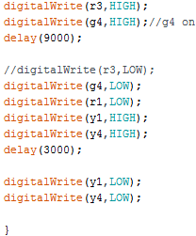
Traffic Light System For Car Crossroads
Programming Codes For The Arduino Traffic Light Controller

Slide 5
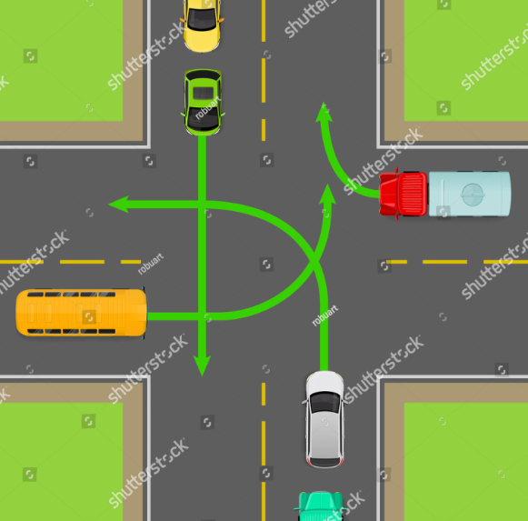
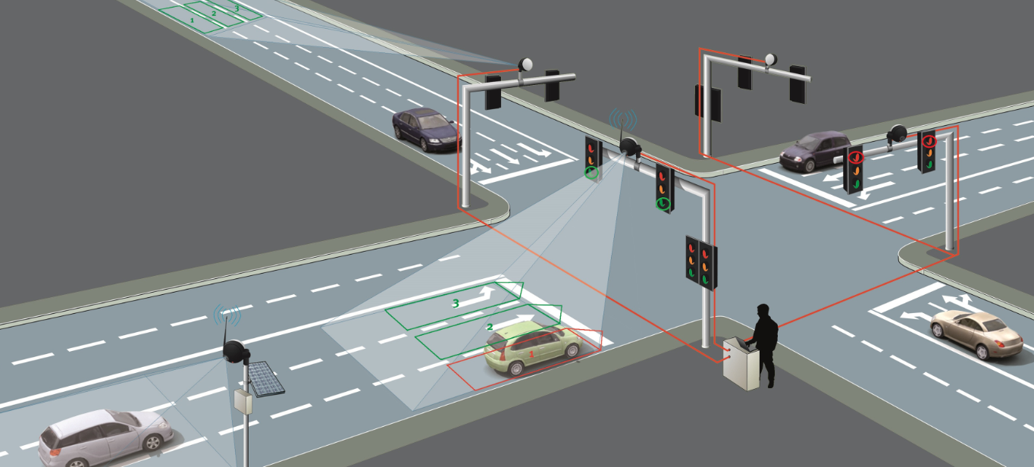
Traffic Light System For Car Crossroads
Working Principle Of Arduino Traffic Light Controller

